Slide 1
FW Compiler Enhancements

Slide 4
Lint Checks
https://jiradocs.internal.synopsys.com/display/C20/Firmware+LSP

Slide 5

Combine Register Write/Read instructions with Mask
Combine the Register write/read instructions with the Mask set/reset

Slide 6

Combine Conditional jump instruction with comparison
Combine the register read and conditional jump instructions into 1 instruction where we can provide the register name and Mask value

Slide 7
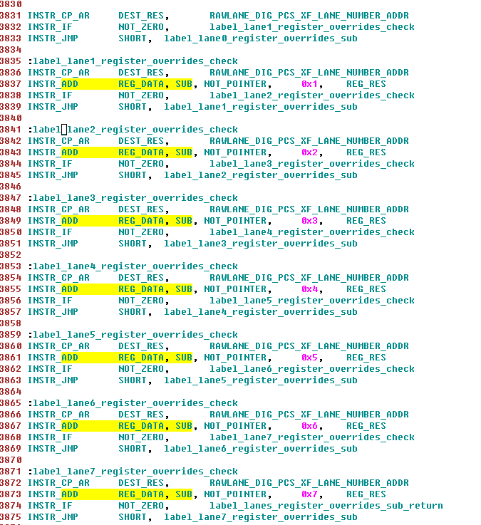
Multi-bit Comparison
Combine the multi-bit comparison

Slide 8
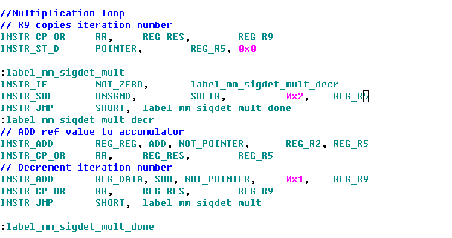
Add a multiplication instruction
Add a multiplication routine which when called will do repeated addition

Slide 9

Conditional Wait/while instruction
Add conditional wait instruction where we wait for a particular register field=0/1 to proceed forward

